Slide 1
Breast Cancer-On-Chip
Presented by: Hanieh Rahimi
Supervisor: Dr. Navaei

Slide 2
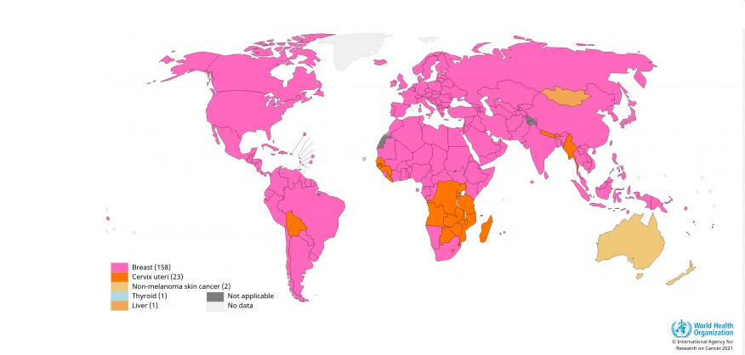
Introduction
Breast cancer is the leading cause of death from cancer in women worldwide, and the second most common cause of death from cancer in women in the United States.
Breast cancer is the primary cause of tumor-related deaths in women worldwide. The 5 year survival rate of patients with primary breast cancer is 99%; however, the 5 year survival rate after secondary metastasis is reduced to approximately 23%.

Slide 3
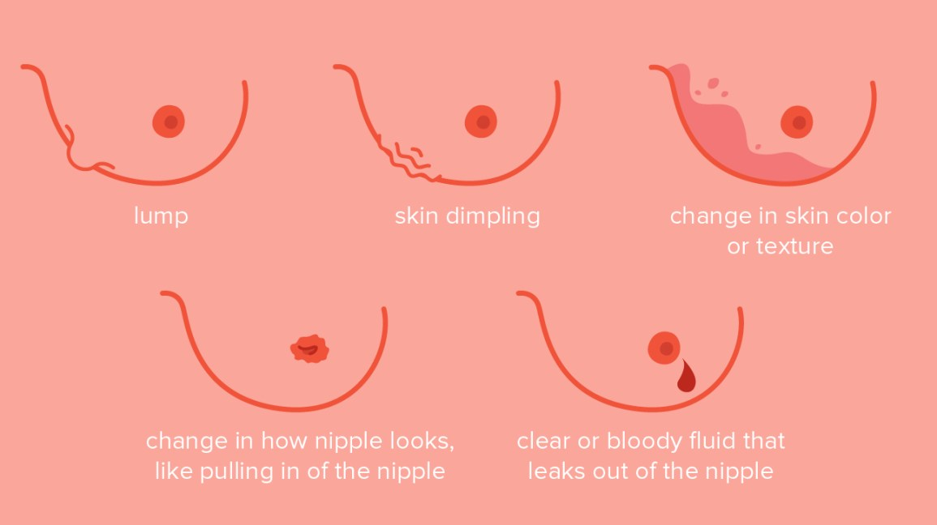
Risk Factors
Aging
Hormones
Family History
Gene Mutations
Radiation Exposure
Drug: DES
Unhealthy Lifestyle

Slide 4
Breast Cancer Pathophysiology

Slide 5
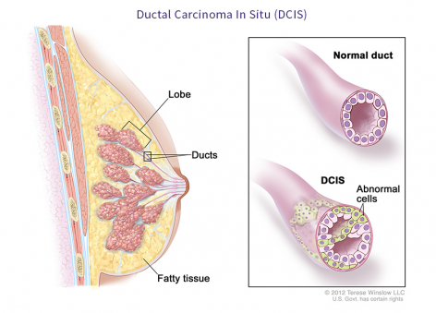
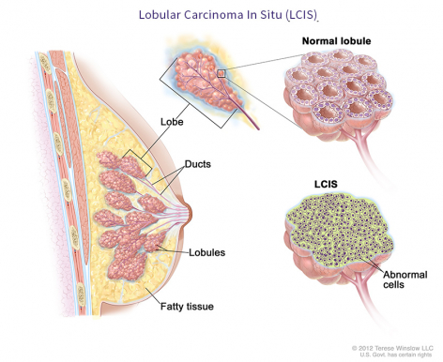
Common Types of Breast Cancer
Ductal carcinoma in situ
Lobular carcinoma in situ
Invasive ductal carcinoma
Invasive lobular carcinoma

Slide 6
Breast Cancer Models

Slide 7
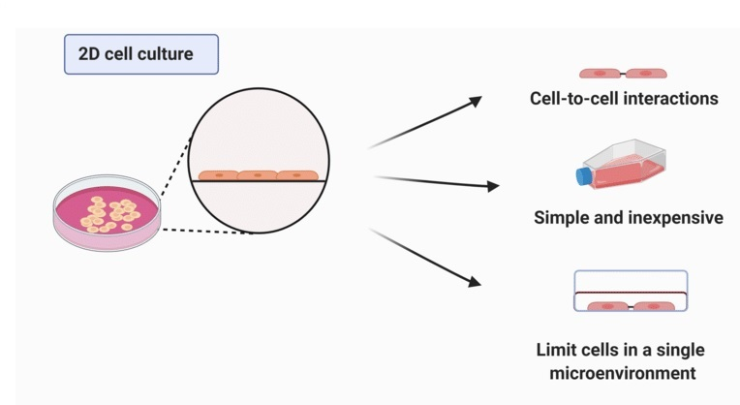
2D Cell Culture
Characteristics | 2D culture
Ease of assay | Easy to perform
Time required | Low
Reproducibility | High
Cost | Low
High throughput screening | Possible
Main applications | Invasion, proliferation, cell-signaling, drug response studies
Sample volume requirement | Low
Biological relevance | Limited relevance (cell display artificial phenotypes and perturbed gene expressions)
Main limitations | Lack of vasculature and cell-matrix interactions Lack of perfusion

Slide 8
B. 3D Cell Culture
Characteristics | 3D culture
Ease of assay | Difficult to form uniform 3D models
Time required | Moderate
Reproducibility | Moderate
Cost | Moderate
High throughput screening | Possible
Main applications | Invasion, cell-cell/matrix interactions, intra and extravasation, hypoxia, drug response
Sample volume requirement | Low
Biological relevance | Higher biological relevance (compared to 2D)
Main limitations | Lack of vascularization Lack of perfusion

Slide 9
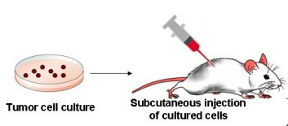
C. In Vivo Culture
Characteristics | in vivo
Ease of assay | Requires specialization. It is also laborious and time-consuming
Time required | Very high
Reproducibility | Low
Cost | Very expensive
High throughput screening | Not possible
Main applications | Metastasis, drug response, mutation studies
Sample volume requirement | High
Biological relevance | Very high biological relevance(compared to 2-D and 3-D); Provides physiological microenvironment and vasculature;
Main limitations | Mostly suffer to demonstrate immunomodulatory effect. Non-predictive

Slide 10
D. Ex Vivo Culture
Characteristics | ex vivo
Ease of assay | Requires optimization. It is time consuming
Time required | Very high
Reproducibility | Low
Cost | Expensive
High throughput screening | Not easy
Main applications | Anticancerous drug testing and biomarkers discovery
Sample volume requirement | High
Biological relevance | Higher biological relevance
Main limitations | Lack of vasculature and perfusion. Short observation period.

Slide 11
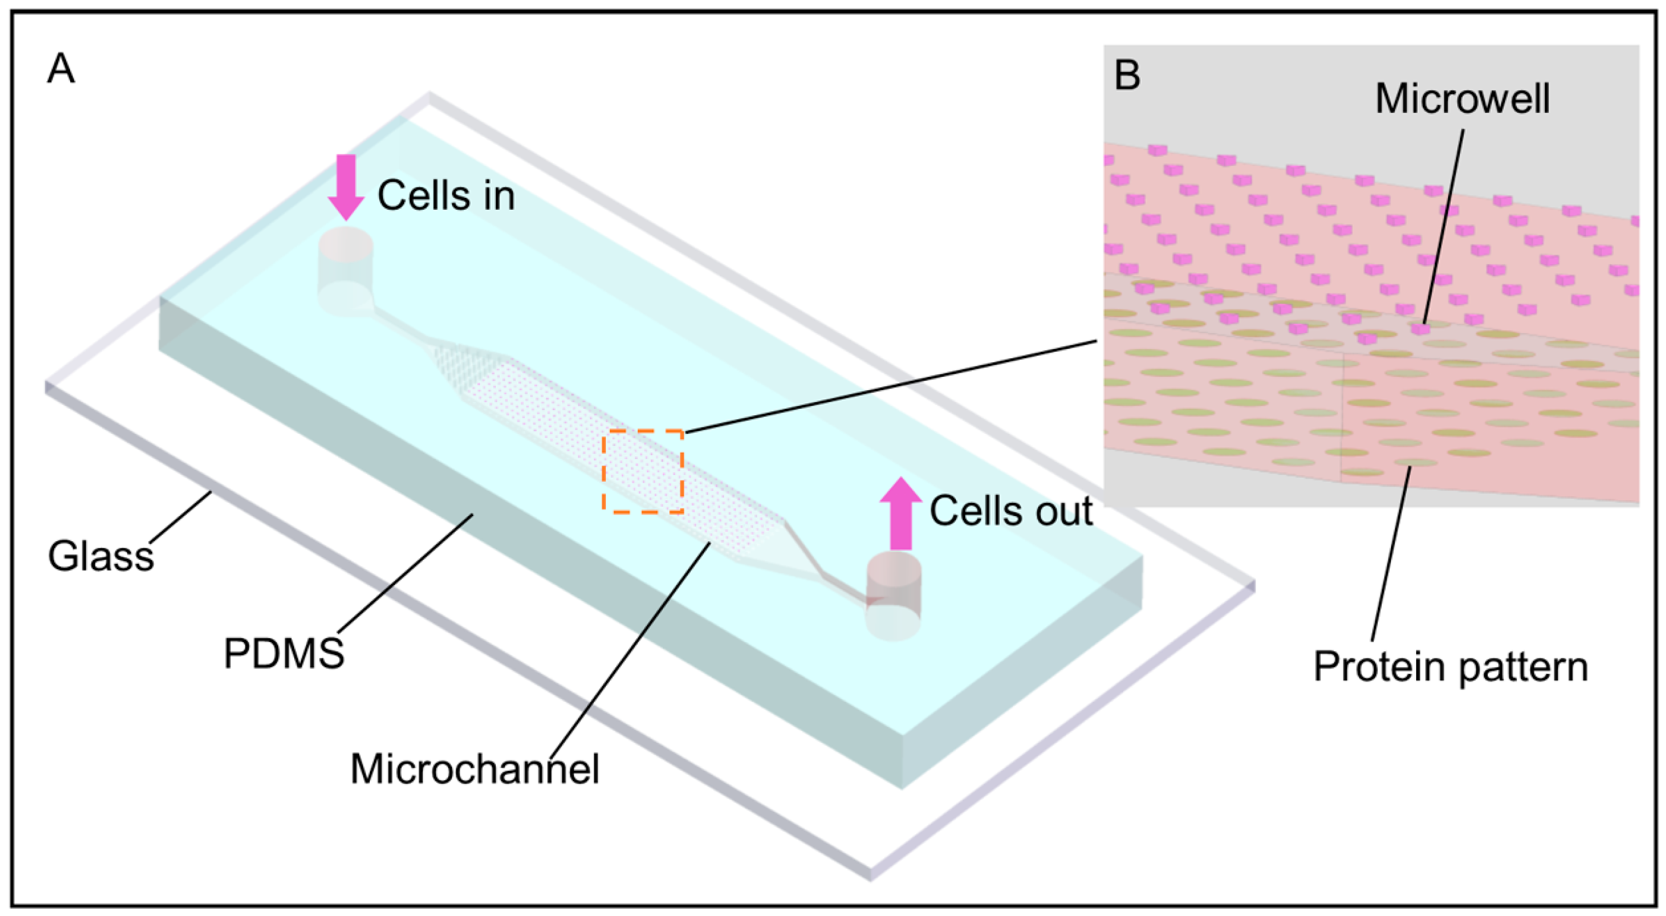
E. Microfluidic
Characteristics | Microfluidic
Ease of assay | Requires specialized equipment for chip fabrication and trained personnel
Time required | Moderate
Reproducibility | High
Cost | Moderate (The assays are cheap but expensive equipment is needed)
High throughput screening | Possible
Main applications | Multicellular interactions and recapitulation of in vivo conditions such as vasculature, fluid flow, biochemical gradient is possible; can incorporate immune cells; provides an ethically relevant substitution of in vivo model
Sample volume requirement | Very low
Biological relevance | Very high biological relevance
Main limitations | Difficult to collect cells for analysis

Slide 12
Applications of tumor-on-chip technology
Detection of breast cancer biomarkers
Drug screening
High throughput breast tumor-on-chip for multiple data analysis
Disease modeling by multi-organ-on-chip systems

Slide 13
Drug screening

Slide 14
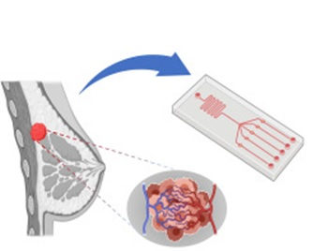
Tumor Microenvironment-On-Chip
Modeling the vasculature: intravasation and extravasation
Mimicking the fluid dynamics of the tumor microenvironment
Chemical and Oxygen Gradient
Modeling tumor-stroma interactions

Slide 15
Tumor Microenvironment

Slide 16
1.Vasculature

Slide 17
2. Co-Culture and Mimicking the fluid dynamics of the tumor microenvironment
Co-Culture
    Mixed Co-culture
    Separate Co-culture
Shear Stress
Pressure

Slide 18
3. Chemical and Oxygen Gradient

Slide 19
Multilayered Breast Cancer Tissue

Slide 20
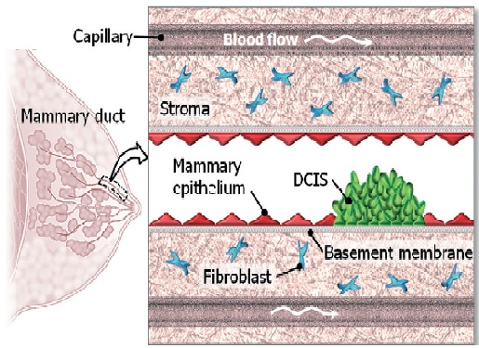
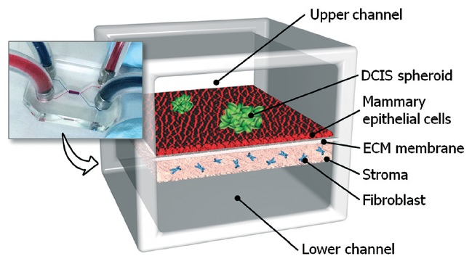
4. Modeling tumor-stroma interactions

Slide 21

Cancer Metastasis On a Chip

Slide 22
Breast Cancer metastasis on chip

Slide 23
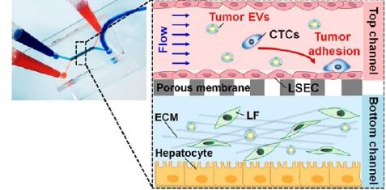
Microfluidic human liver-chip recapitulates breast cancer liver metastasis

Slide 24
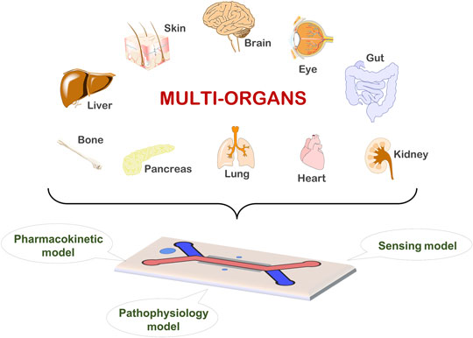
Conclusion
Tumor-on-chip model can compensate the use of 2D and 3D models by recapitulating 3D breast tumor microenvironment, co-culturing breast tumor cells along with neighboring stromal cells and create a more physiologically relevant tumor model.
This organ-on-chip model can also fulfill the criteria to study metastasis cascade and perform in vitro drug screening platform. Advancement in this technology can reduce the cost and time of the drug development procedure and increase the precision of breast cancer therapy.

Slide 25


